Slide 1
Subdomains vhost

Slide 2
End goal
Each project should be hosted on your webserver
Under a different subdomain:
http://test-project.localhost
We don’t have a DNS server running
So we’ll hack the hosts file

Slide 3
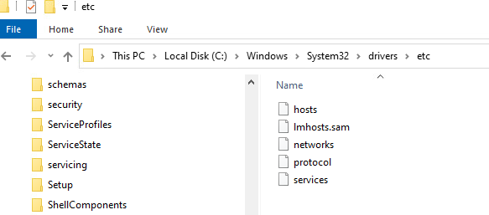
Hosts file

Slide 4
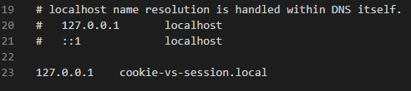

Slide 5
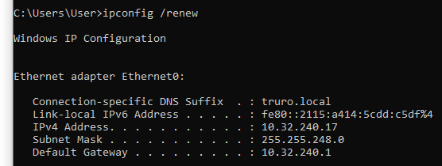
Open a cmd
Type:
ipconfig /renew
This tells windows to reload the hosts file

Slide 6
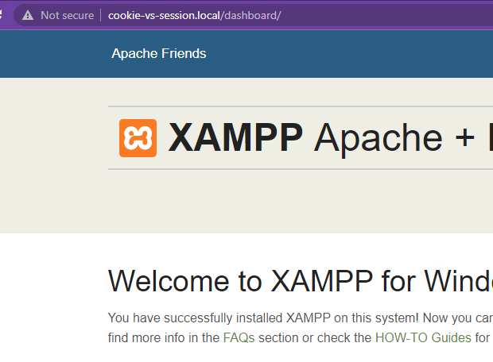
Check the new domain name works

Slide 7
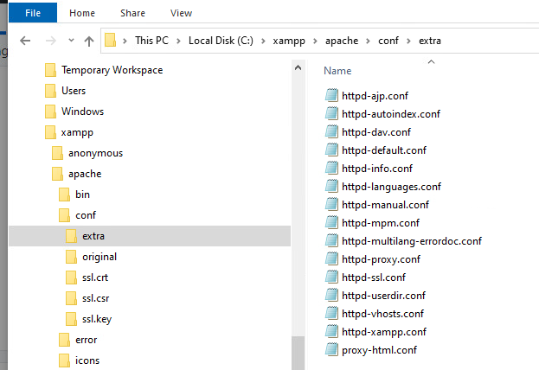

Slide 8
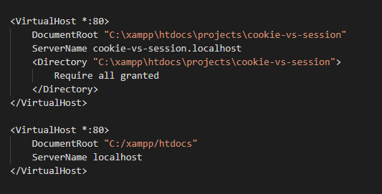
Next we need to tell apache
To do a different thing
If the domain name is different
NOTE THE ORDER OF THE SUBDOMAINS

Slide 9
